Slide 1
SDLC
SDLC: software develop life cycle
STLC: software testing life cycle
Module of SDLC
Waterfall, Spiral module, V module.
5 stages
1. Customer requirement 2. designing 3. coding 4. testing 5. deployment

Slide 2
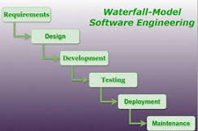
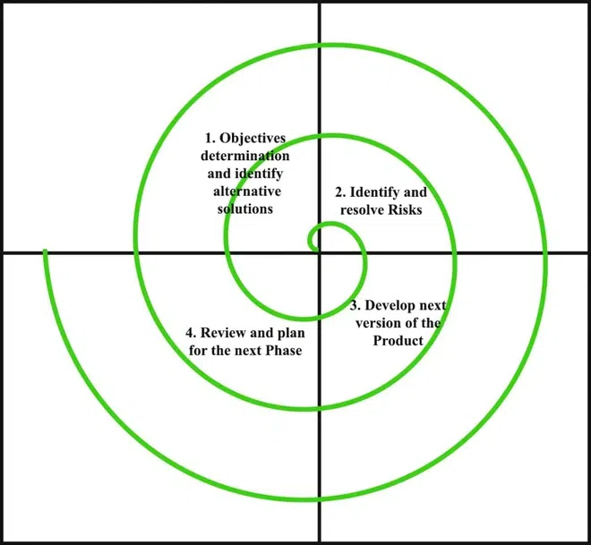
Water-fall, Spiral model
The waterfall model: It involves a sequential approach to software development, where each phase of the project is completed before moving on to the next one.
Spiral Model: Each phase of the Spiral Model is divided into four quadrants. If one part is work, other parts are free. When it works it add or make something new.

Slide 3
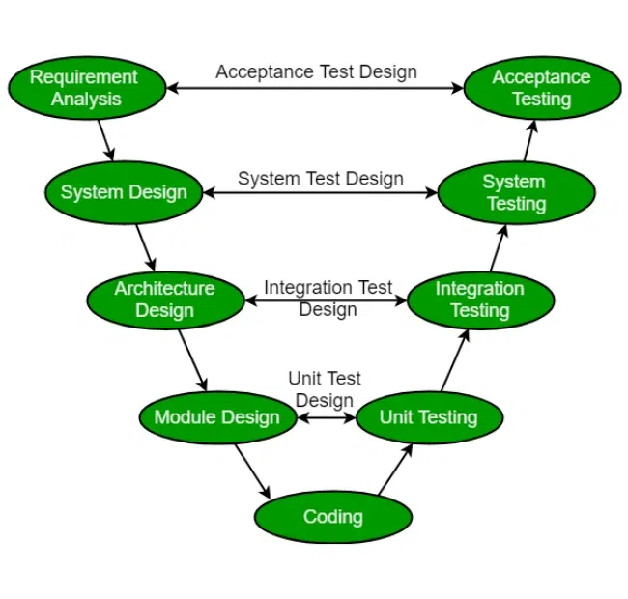
V-module
The V-Model is a software development life cycle (SDLC) model that provides a systematic and visual representation of the software development process. It is based on the idea of a “V” shape, with the two legs of the “V” representing the progression of the software development process from requirements gathering and analysis to design, implementation, testing.

Slide 4
Requirement Analysis
BRS: Business requirement specification
SRS: Software requirement specification
Requirement: Customer's need. Code
Unit testing: check that each codes work well.
Integration test: combine unit and check it cobining code works well.
System test: ex) Real Steering check.

Slide 5
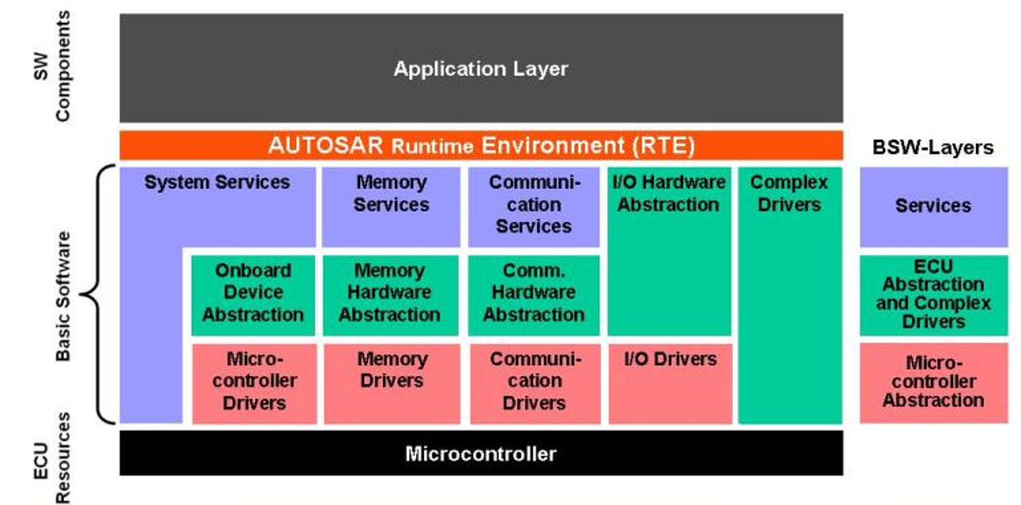

Slide 6
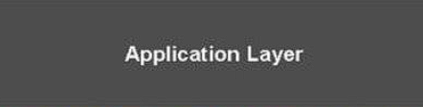


DIO Driver
Dio_ReadChannel
Dio_WriteChannel
Dio_ReadPort
Dio_WritePort
Dio_GetVersionInfoF
Port Driver
Port_Init
Port_SetPinDirection
Port_RefreshPortDirection
Port_GetVersionInfo
Port_SetPinMode
Connect Application, BSW
Dio_ReadChannel | Dio.h | Returns the value of the specified DIO channel.
Dio_ReadChannelGroup | Dio.h | This Service reads a subset of the adjoining bits of a port.
Dio_ReadPort | Dio.h | Returns the level of all channels of that port.
Dio_WriteChannel | Dio.h | Service to set a level of a channel.
Dio_WriteChannelGroup | Dio.h | Service to set a subset of the adjoining bits of a port to a specified level.
Dio_WritePort | Dio.h | Service to set a value of the port.
Port_Refresh-PortDirection | Port.h | Refreshes port direction.
Port_SetPinDirection | Port.h | Sets the port pin direction
Port_SetPinMode | Port.h | Sets the port pin mode
DIO.h
PORT.h

Slide 7
Component design
Objectives: Describe objective of document
Scope: Describe scope of document ex) Blinking LED project.
Terms: explain the word
Acronyms: ex) MCU - MicroControllerUnit
Reference: write document where I get information

Slide 8
Component design
Software function
Logic design - flow chart
Interface - input, output
EB tresos configuration (screen shot)
Detail about function (what we use in code)

Slide 9
JTAG
JTAG? - Joint Test Action Group, debugger.
JTAG 4 pins - TDI, TDO, TCK, TMS
TDI - Test Data In
TDO – Test Data Out
TCK – Test Clock
TMS - Test Mode Select
MCU -> Clock -> Clock setting configuration.
PLL – Phase-Locked Loop, control system that generates an output signal

Slide 10
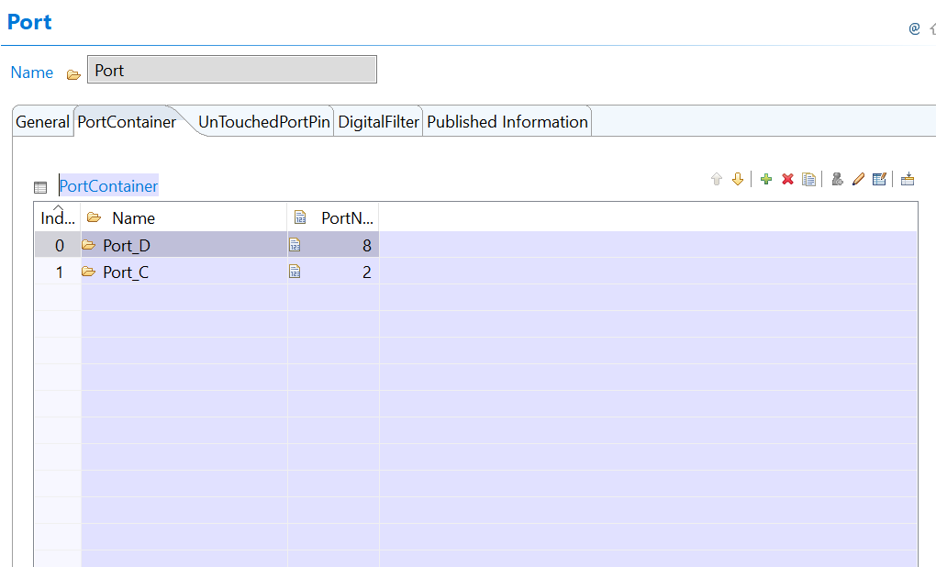
EB Tresos
Port
We use Port D
& PORT C

Slide 11
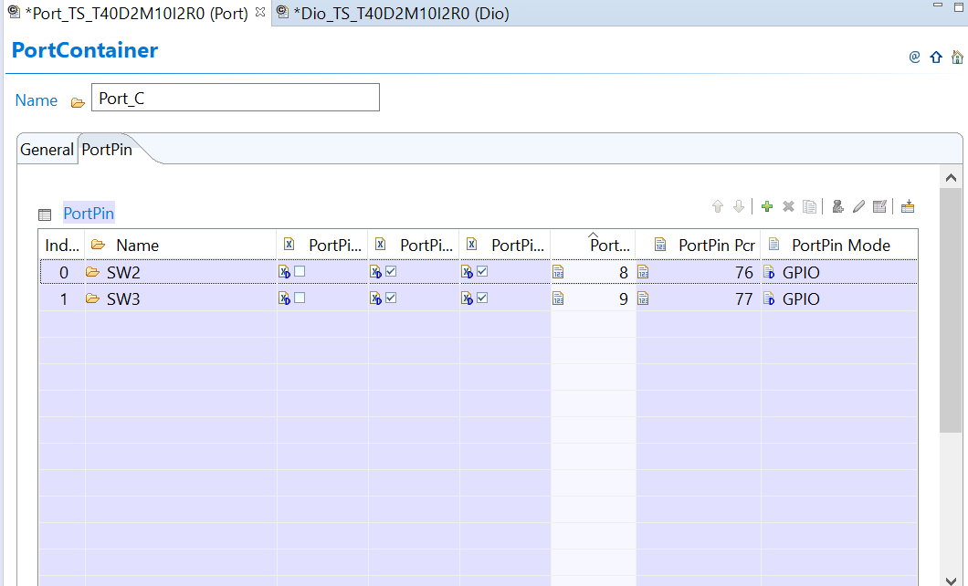
EB Tresos
In Port_C
SW2
32*2 +12 = 76
SW 3
32*2 + 13 = 77

Slide 12
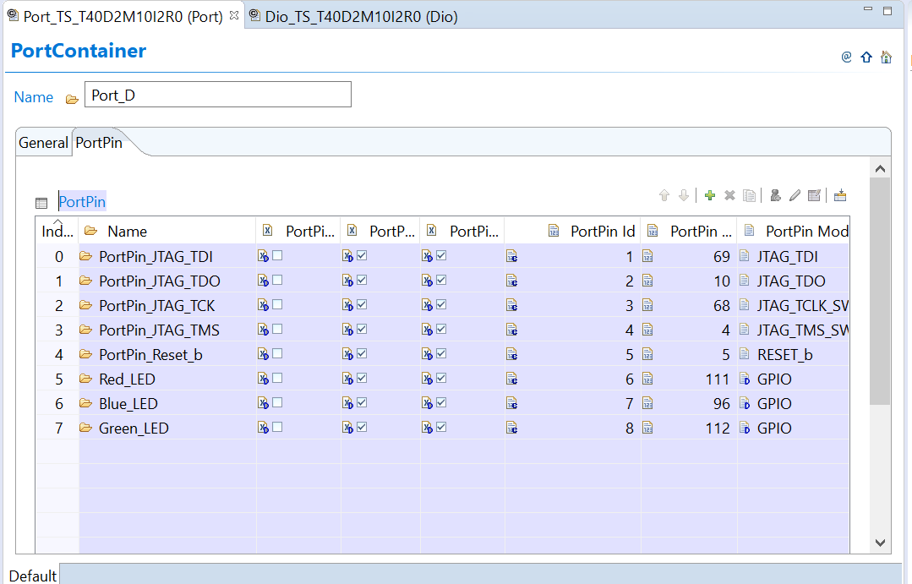
EB Tresos
In Port_D
Red_LED
32*3 + 15 = 111 Blue_LED
32*3 + 0 = 96
Green_LED
32*3 + 16 = 112

Slide 13
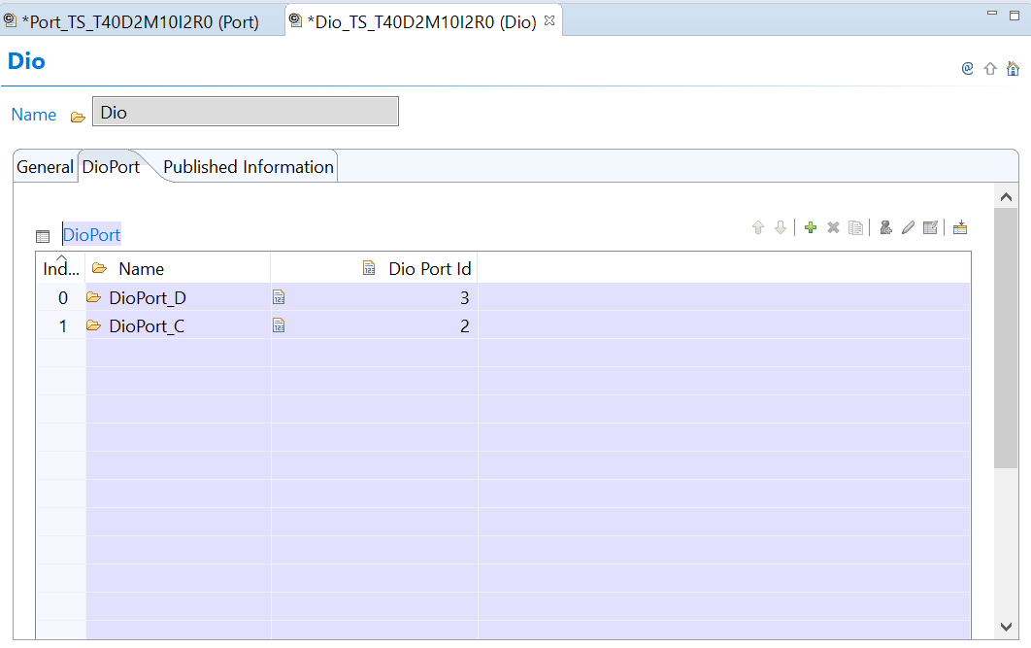
EB Tresos
DIO

Slide 14
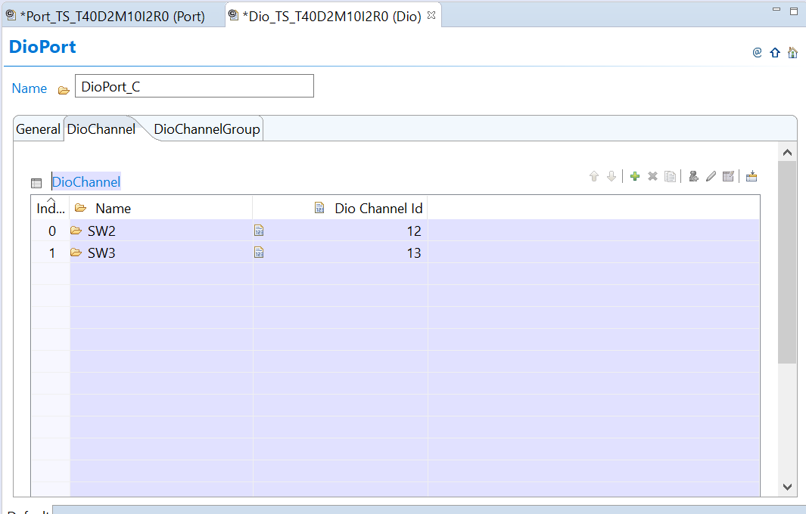
EB Tresos
In DioPort_C
SW2 – 12
SW3 - 13

Slide 15
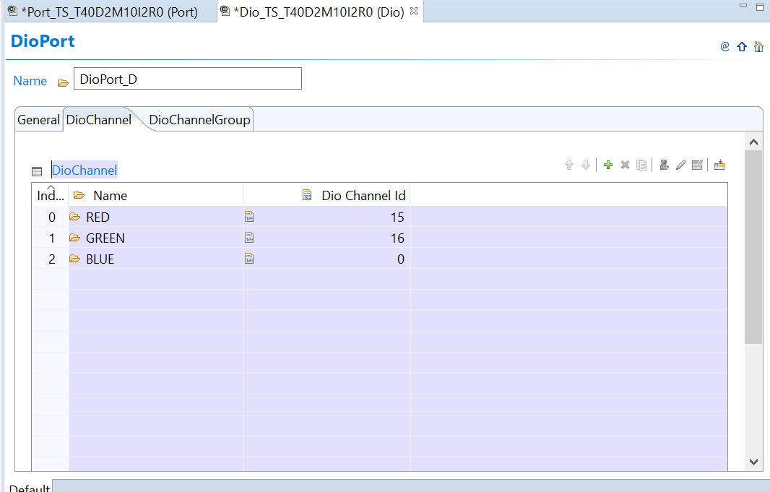
EB Tresos
In DioPort_D
Red_LED – 15
Green_LED - 16 Blue_LED - 0

Slide 16
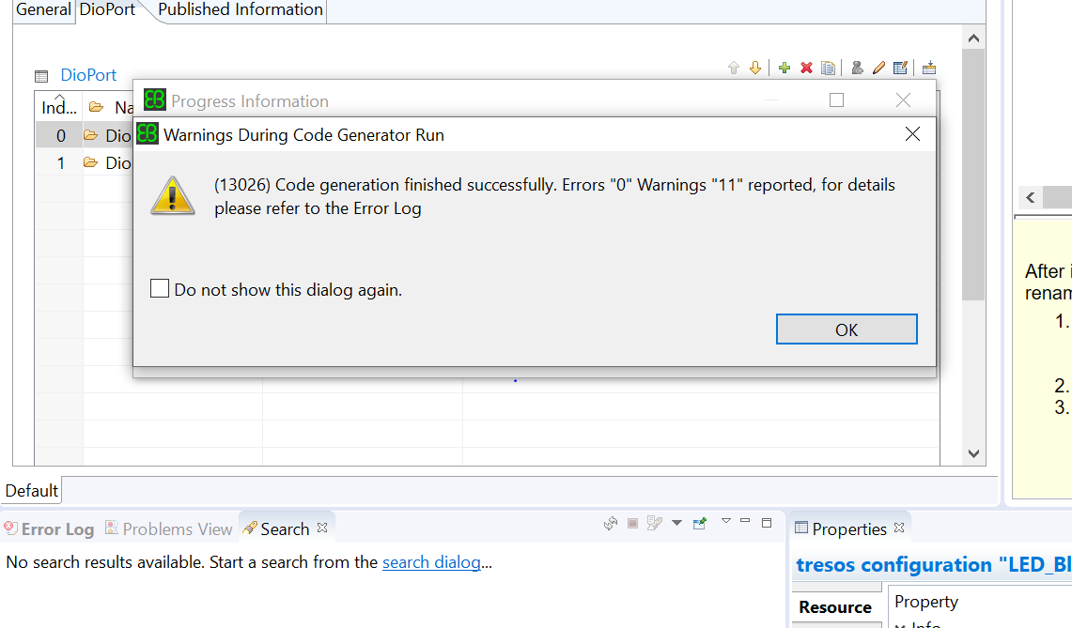
EB Tresos
Verify Project
Generate Project
Make a output folder.

Slide 17
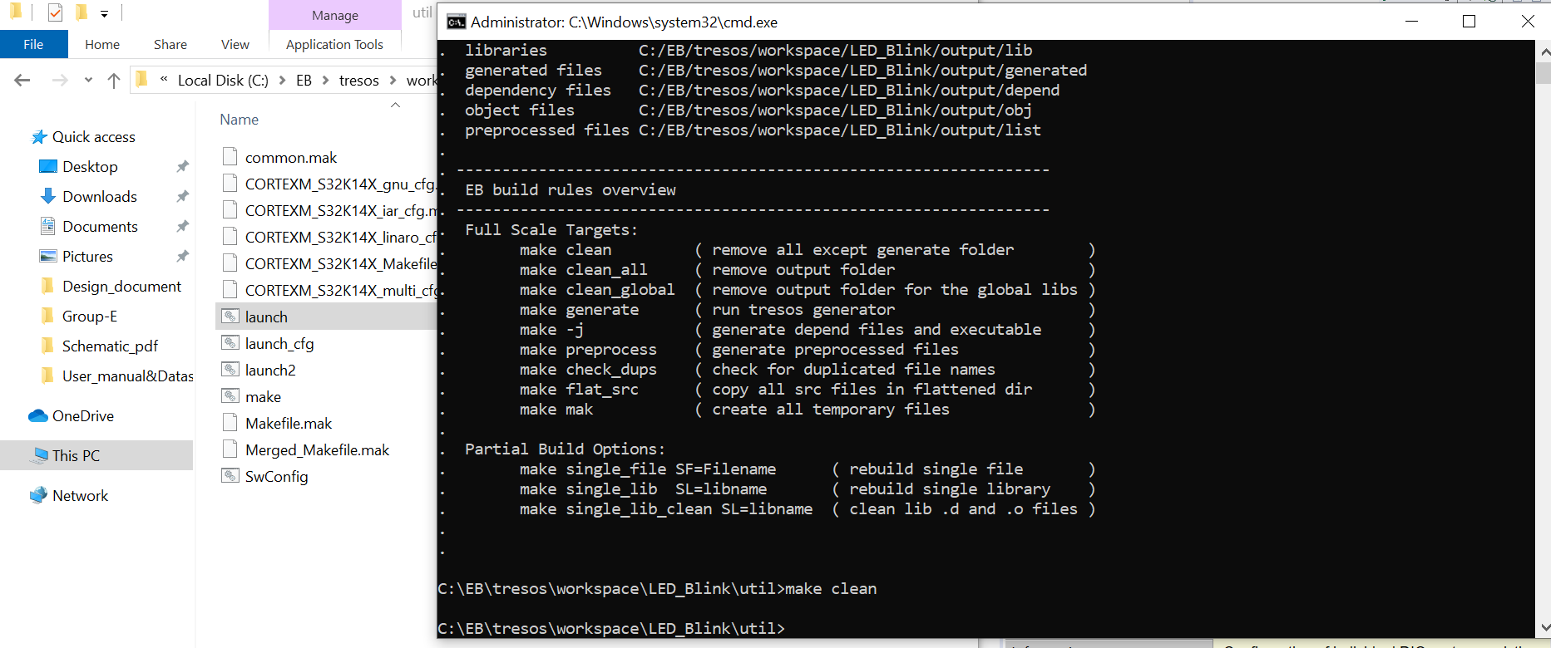
EB Tresos
Make clean
Remove all except
Generate folder

Slide 18
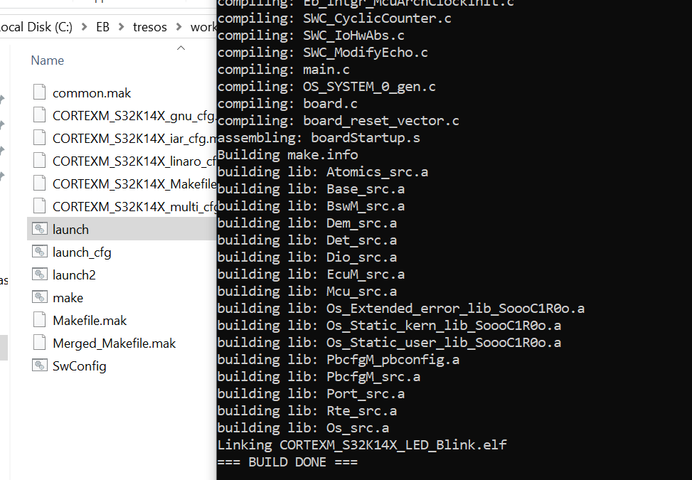
EB Tresos
Make – j
Make a .elf file

Slide 19
SW-C
SWCD: SoftWare Component - Description
Runable, port(3), interface(6), connector
2 ECU communication
1. Intra ECU comunication
ECU To communicate with other ECU - Using BSW layer
2. Inter ECU comnunication

Slide 20
SW-C
Methodology: how to do a project.
OEM: Enterprise that give a product request.
System.arxml
Ex) Steering, Break, etc...
connection
Topology – ECU - SWC
Topology: Configuration and connection structures
OEM give us a information.

Slide 21
SW-C
Service Component Description
CANIF-Code generator
RTE - Not in tresos.
.c, .h (source in BSW) <-> arxml <-> .xdm file <-> .c , .h (source code)
Sender – Receiver (1 way) / Server – Client (2 ways)
2 Port = 4 Interface
Interface (In port, input, output)

Slide 22
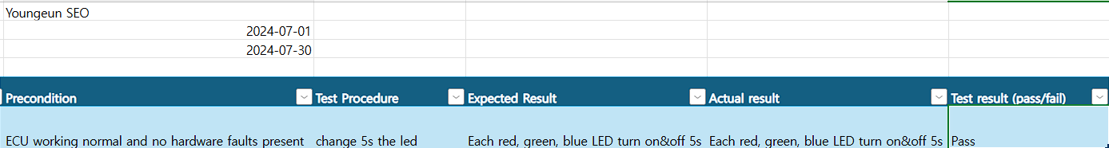
Test

Slide 23
